Slide 1
Project Food Sense

Slide 2
Problem Statement
To use nature inspired algorithms to determine the quality of food items using various gas sensors and camera

Slide 3
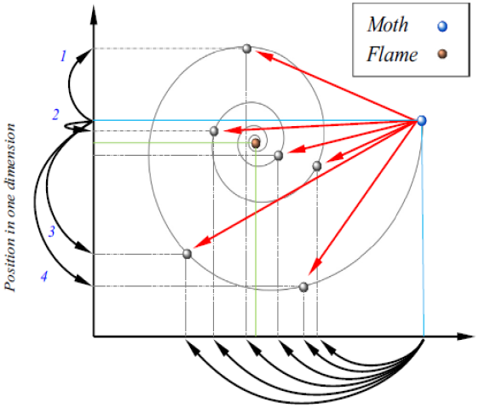
Moth Flame Optimization (MFO)
Fitness measure : distance of moth from corresponding flame
Moth position updation: using logarithmic spiral
Adaptive decrease of no of flames: for convergence

Slide 4
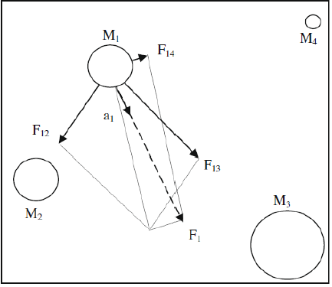
Gravitaitonal Search Algorithm (GSA)
Mass updation of agents : proportional to fitness
Role of G Updation in convergence

Slide 5
GSA + MFO Hybrid
Assign mass concept to Moths in MFO
Communication between moths because of both MFO and GSA
Increase the mass of the fitter moth - GSA
Moths spiral around fit flames - MFO

Slide 6
Hybrid Algorithm (Contd.)
Moth motion is guided by not just by flames but by masses of other moths
Ideally, faster convergence

Slide 7
Pseudo Code
initialize moth_position, moth_velocity, moth_acceleration
calculate initial fitness for each moth
while(iteration < max_iteration)
update flame_number
if (iteration == 1)
F = sort(M)
F’ = sort(M’)
else
F = sort(M_{t}-1, M_{t})
F’=sort(M_{t}−1, M_{t});
end
for i=1: n
for j=1: d
update r and t
D(i) = |F(i) – M(i)|
M(i) = D(i) . e^{bt} . cos(2∏t) + F(j)
end
end
G = G₀(1/iteration)^{b}
for i=1:n
mass(i) = 1/fitness(i)
for j=1:n
r = moth_position(i) – moth_position(j)
F = G*mass(j)/r
end
moth_velocity(i) = moth_velocity(i)*rand(0,1) + F
moth_position(i) = moth_position(i)*rand(0,1) + moth_velocity(i)
end
end

Slide 8
Mass Fitness Relationship
GSA - Measure of Fitness is mass
MFO - Measure of Fitness is distance to fittest moth
GSA works on the premise that fitter agent attracts others towards itself

Slide 9
Mass Fitness Relationship
Hybrid algorithm, exploits this behaviour
Hybrid - Measure of Fitness is distance to fittest moth
Fittest moth has highest mass

Slide 10
Problems Faced - G Updation
Stagnation of algorithm for values in the order of G0
Reason for stagnation - Slow decay of G
1/t vs 1/t² vs b^{t} where b<1 and t = iteration no
Slow decay of G: results in deviation of Moths from optimum value
Updated decay of G to facilitate faster convergence without stagnation
As iterations progress, decrease the GSA motion

Slide 11
Problems Faced - Mass Updation
Mass Updation according to previous mass
Mass(i) = Mass(i) + Fitness(i) / Sum(Fitness(i))
Effective increase in mass of moth was negligible in this case
Replaced with Mass(i) = 1 / fitness(i)

Slide 12
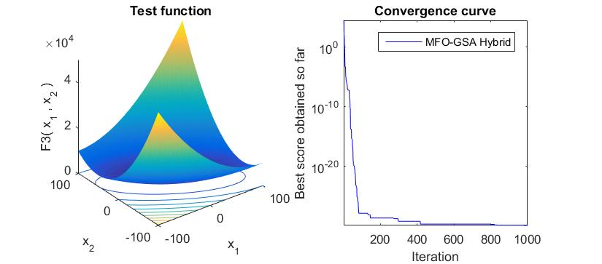
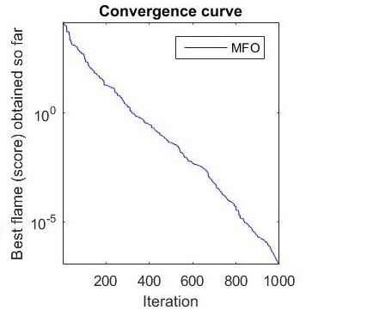
Results

Slide 13
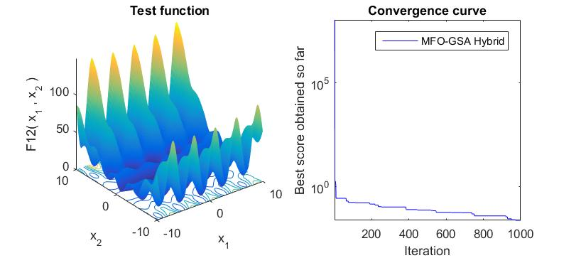
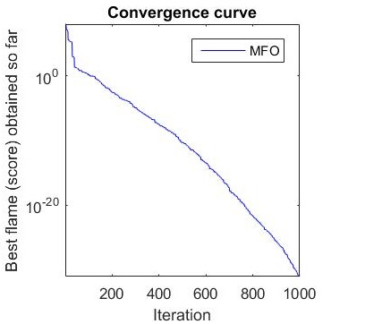
Results (Contd.)

Slide 14
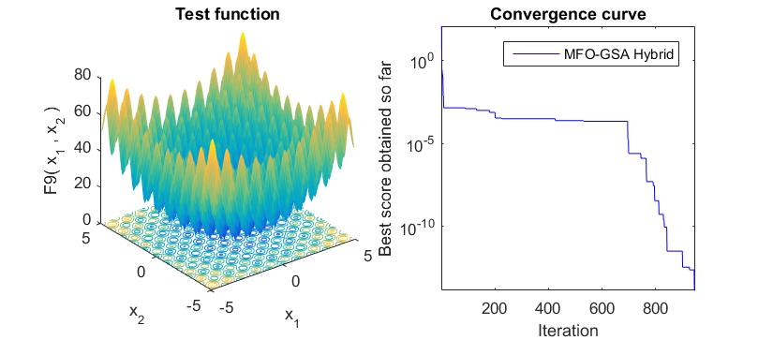
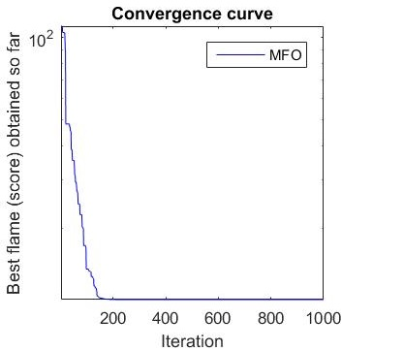
Results (Contd.)

Slide 15
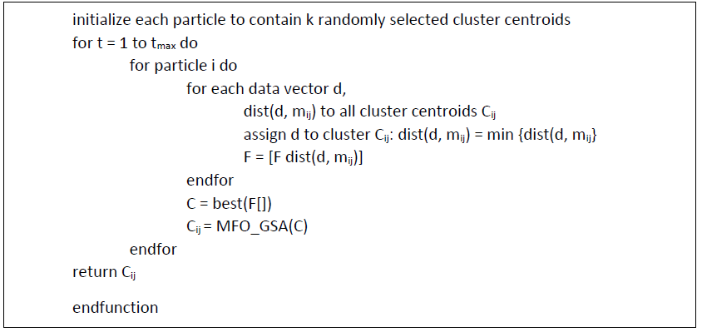
Optimized K-Means

Slide 16
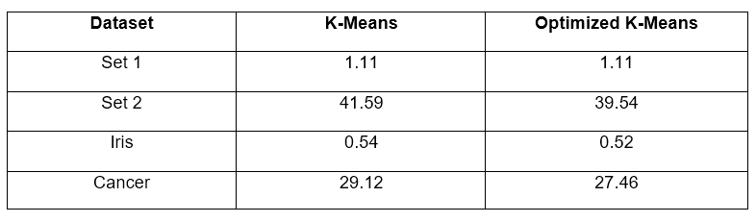
Results of Optimized K-Means

Slide 17
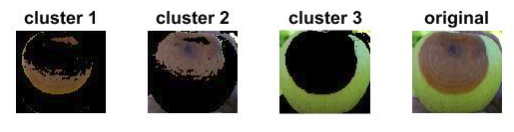
Image Segmentation: K-Means
Convert image to LAB color space
Apply optimized K-Means on a and b

Slide 18
Image Segmentation: Multi-Level Thresholding
Segment the image using thresholds
Thresholding: manual process
Brute force: Computationally expensive
Optimization approach

Slide 19
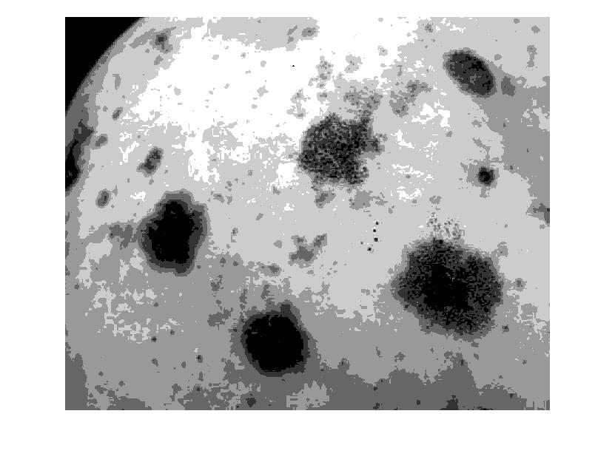
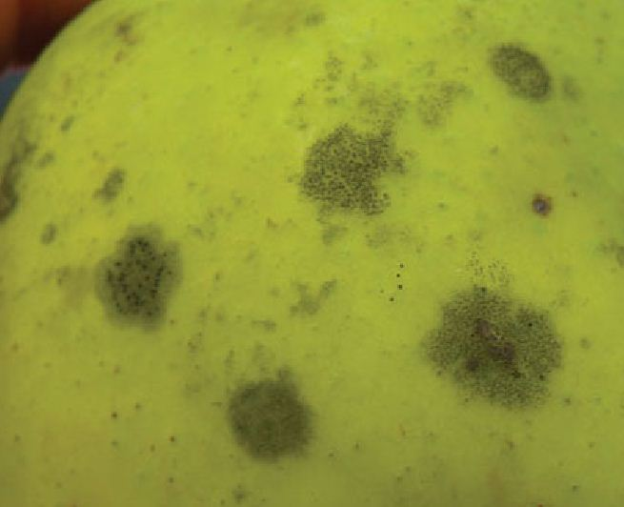
Image Segmentation: Multi-Level Thresholding II
Search for threshold values
Fitness function: S_{inter_cluster} / S_{intra_cluster}

Slide 20
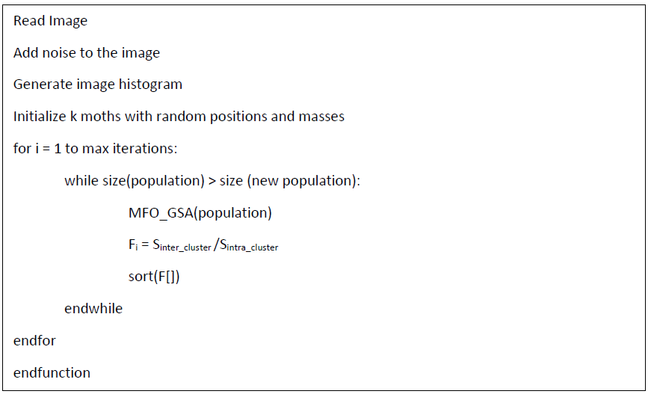
Image Segmentation: Multi-Level Thresholding III

Slide 21
Feature Extraction
Local Binary Pattern
Grey Level Co-occurrence Matrix
Haralick Features

Slide 22
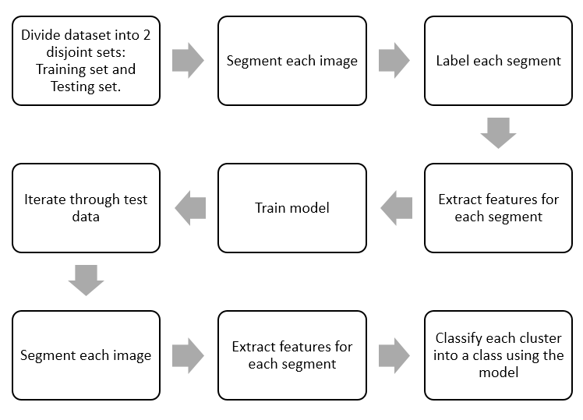
Classification

Slide 23
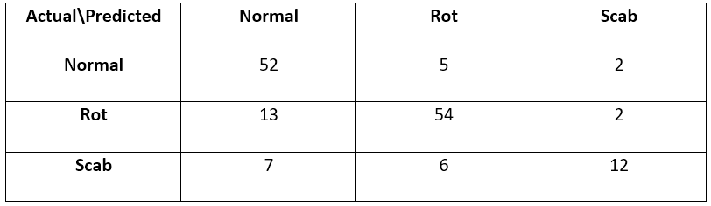
Classification Results
The accuracy for our multiclass model is 80.37%

Slide 24
Future Work
Collect gas sensor data
Extend to other food items
Explore other texture analysis for other food items

